Slide 1
Capstone – Predicting the Effects of Unemployment and Education on Crime
Andre Velez

Slide 2
Project Overview
Introduction and Goals
Data Sets
Data Extraction
Exploratory Data Analysis
Model Generation
Results
Conclusions and Recommendations

Slide 3
Introduction and Goals
Problem
Violent crime deteriorates the health, prosperity, and economic freedom
Exodus of market movers and job creators to ‘greener pastures’
Downward spiral effect on at-risk communities
Goals
Identify features that impact violent crime rate
Compare and contrast differences between statistically safe and violent cities
Craft models to guide policy creation with data-driven analysis

Slide 4
Data Sets
FBI Crime Data
Collection of crime records by city, broken down into annual reports
Focus on violent crime
Paired with population census data to construct investigation factor: Violent Crime Rate (VCR)
Unemployment Data
Organized by county
Paired with state/county/city and population data sets
College Scorecard Data
Table of over 50 variables, potential future investigations
Limitations
Unknowable amount of variables
Correlation does not mean causation

Slide 5
Data Extraction
Clean Data for Analysis
Crime Data Sets
Unemployment Data Set
College Score Data Set
Population Data Set

Slide 6
Exploratory Data Analysis
Questions to Explore
Which features exhibit correlation with VCR?
What are (if any) the differences between the safest and most violent cities?
What do the central tendencies reveal?
What is our model hypothesis?

Slide 7
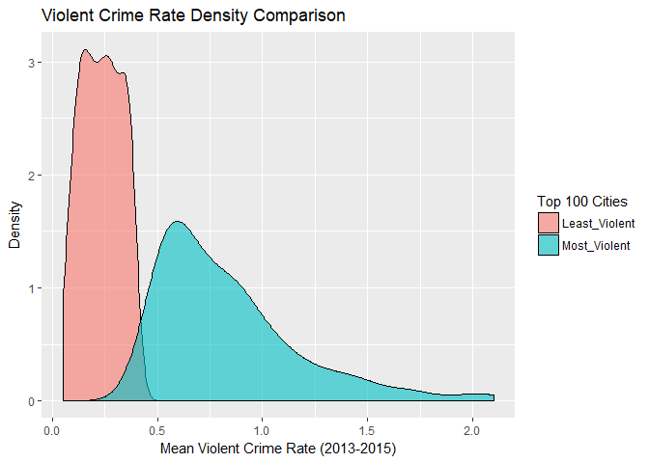
Exploratory Data Analysis
Data ranked by VCR, analyzed separately for comparison
Top 100 most violent cities’ spread of data is 5x greater when compared to the least violent cities

Slide 8
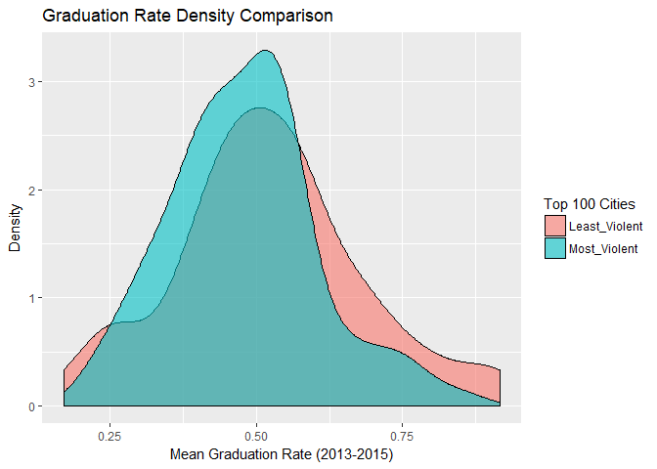
Exploratory Data Analysis
GR distribution shifted left, tighter interquartile range for violent cities

Slide 9
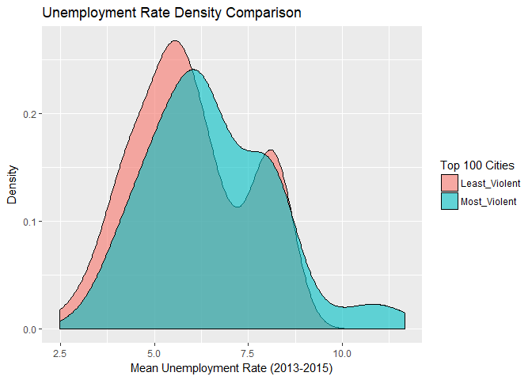
Exploratory Data Analysis
UR distribution shifted right for violent cities
Bimodal shape could be lack of data

Slide 10
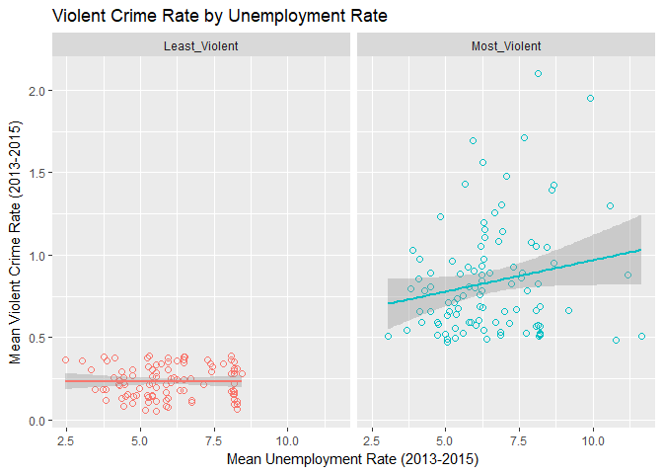
Exploratory Data Analysis
Slight positive correlation of UR to VCR in violent cities

Slide 11
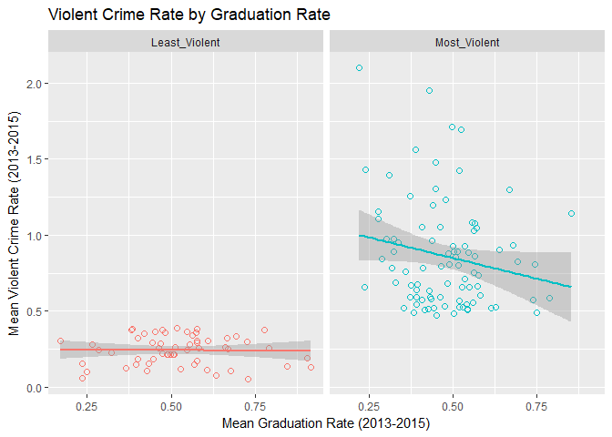
Exploratory Data Analysis
Slight negative correlation of GR to VCR in violent cities

Slide 12
Model Generation
Hypothesis to Test
Violent crime is significantly effect by the availability of jobs and access to higher education
Machine Learning
Goal: Build a model with predictive power for VCR for both violent and safe city data sets
Model of choice: Linear Regression
Potential Features of Impact
Unemployment Rate
College Graduation Rate
Median Income
Median Debt
College Retention Rate
Average Cost of College

Slide 13
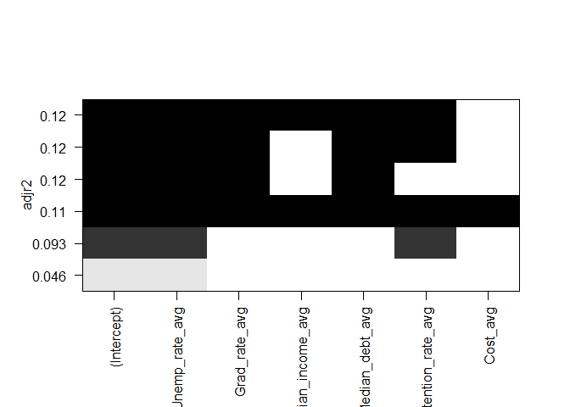
Model Generation
Violent City data set
Adjr. R2 is a measure of fit of our model to our data
Darker = better fit
More features ≠ better model
Optimal model = Graduation Rate + Unemployment Rate + Median Debt

Slide 14
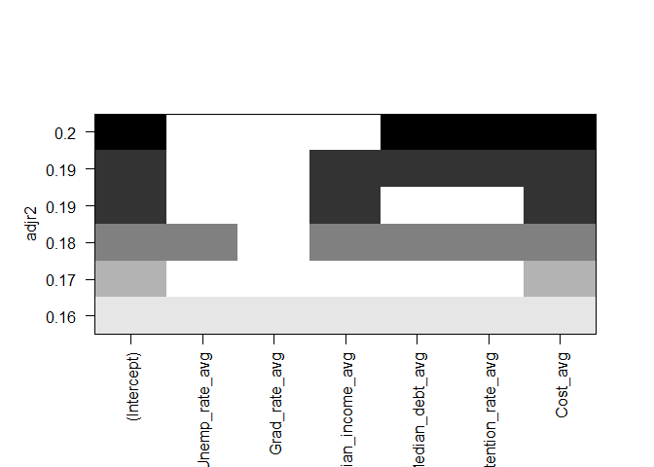
Model Generation
Safe City data set
Adjr. R2 is a measure of fit of our model to our data
Darker = better fit
More features ≠ better model
Optimal model = Average College Cost + Median Debt + Median Income + College Retention Rate
Why not choose “darkest”?

Slide 15
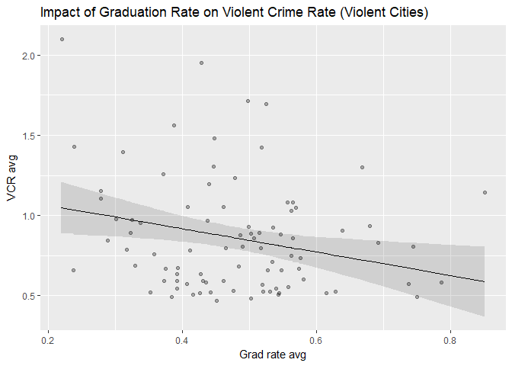
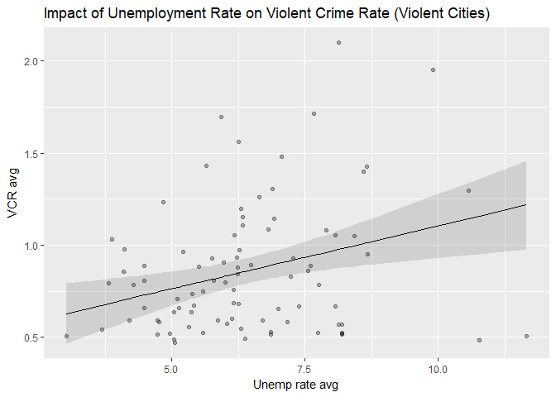
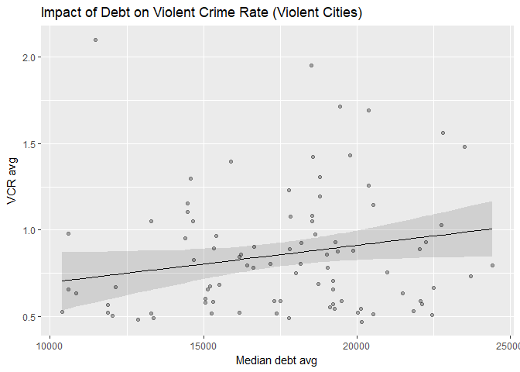
Results
Use Model 5 for violent cities
Graduation Rate, Unemployment Rate, Median Debt
*Assumptions of the features
Not to be extrapolated individually for unseen data
Must use the entire model

Slide 16
Results
Slight negative trend
Increasing college graduation rate can decrease crime rate
Example: Raising grad rate by 50% decreases crime rate from 0.86% to 0.68%.

Slide 17
Results
Slight positive trend
Decreasing unemployment can decrease crime rate
Example: Lowering unemployment by 50% decreases crime rate from 0.86% to 0.64%.

Slide 18
Results
Slight positive trend
Decreasing debt can decrease crime rate
Example: Lowering debt by 50% decreases crime rate from 0.86% to 0.67%.

Slide 19
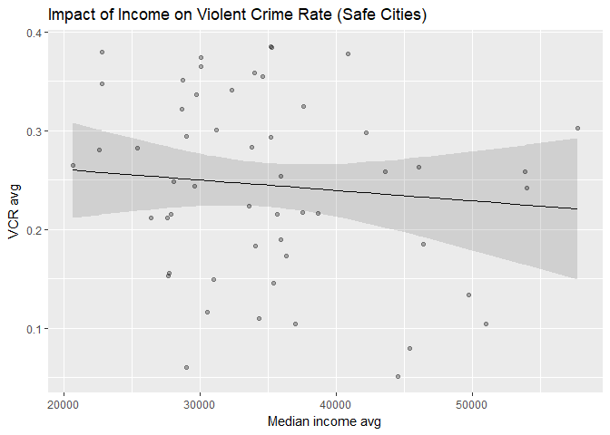
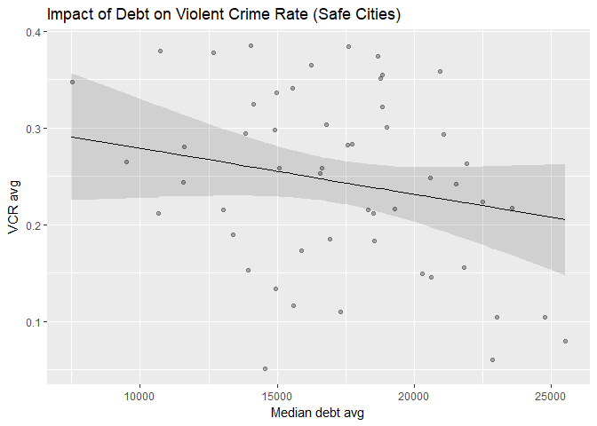
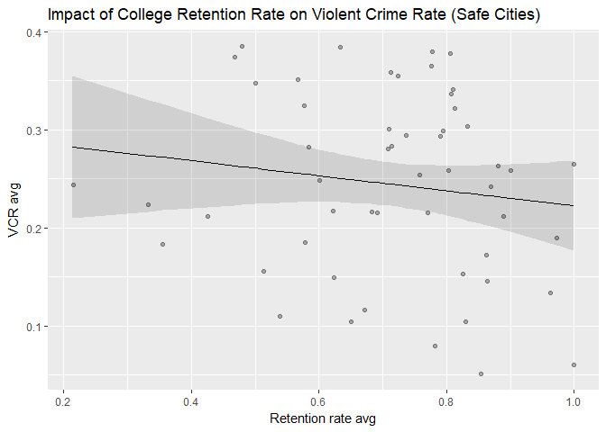
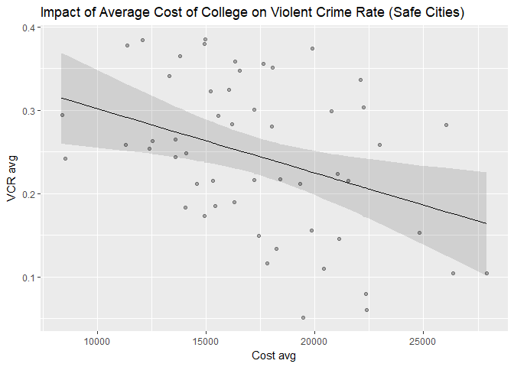
Results
Use Model 3 for safe cities
Median Income, Median Debt, College Retention Rate, Cost of College
*Assumptions of the features
Not to be extrapolated individually for unseen data
Must use the entire model

Slide 20
Results
Slight negative trend
Increasing income can decrease crime rate
Example: Raising income by 50% decreases crime rate from 0.24% to 0.22%.

Slide 21
Results
Slight negative trend
Decreasing debt can increase crime rate
Example: Lowering debt by 50% increases crime rate from 0.24% to 0.28%.
Seems counter intuitive
Outside factors
“Good debt”

Slide 22
Results
Slight negative trend
Increasing retention can decrease crime rate
Example: Raising retention by 50% decreases crime rate from 0.24% to 0.23%.

Slide 23
Results
Slight negative trend
Decreasing cost of college can increase crime rate
Example: Lowering cost by 50% increases crime rate from 0.24% to 0.31%.
Also seems counter intuitive
Outside factors
Higher cost may correlate to higher quality of institutions

Slide 24
Conclusions
Model Selection to Predict VCR
Underwent 4 different methods to validate strength of models
Model 5 for violent cities
Model 3 for safe cities
Hypothesis Check
Violent crime in violent cities is significantly impacted by unemployment rate, college graduation rate, and median debt of its population
Violent crime is safe cities is significantly impacted by median income, median debt, average cost of college, and retention rate of colleges

Slide 25
Recommendations
Policy
Collect more data on job and educational opportunities to create a more robust model
Determine where your cities lies based on its violent crime rate
Budget for more preventative measures in addition to law enforcement
Improve the job market, reduce the cost of education, reduce the incentive to be in debt,
Look to answer different questions with different machine learning models
Base policy on data-driven analysis over ideological dogma

